Slide 1


Project Phase Progress-1 Review Presentation & Demonstration “Weather Application System”
By
1.Aman Kumar (1RN20CS016)
2.Ayush Dixit (1RN20CS029)
3.Divyansh Tiwari (1RN20CS042)
4.Aditya Sudhanshu (1RN20CS012)
Guide:
Dr Hemanth S
Asst. Prof. Dept. of CSE, RNSIT
Department of Computer Science and Engineering
RNS INSTITUTE OF TECHNOLOGY
2021-22

Slide 2
CONTENTS
INTRODUCTION
Problem Statement
Existing System and Limitations
Proposed system
SYSTEM ARCHITECTURE/BLOCK DIAGRAM
Flow charts
Sequence diagrams
IMPLIMENTATIONS (Module wise)
Algorithm/Methods/Pseudo code
CONCLUSION
Conclusion
Future work to be carried out
REFERENCES

Slide 3

INTRODUCTION
Problem Statement:
To create and maintain a weather app where user can fetch weather details of any place on earth also save as favorites for future references

Slide 4

Introduction
Existing System And Limitation:
There Are Already So Many Weather Apps Available On Internet But They’re Just Handful Of Those Which Uses Primitive Language Like C. And Here Lies System Limitations.

Slide 5
System requirements
Min Requirements
Network Interface Card (Active Internet)
32 Kilobytes Physical Memory
Single Core Single Thread CPU @ 100Mhz
HID Input Device ( preferred keyboard )
HID Output Device ( preferred monitor )
Supporting Operative System(Windows, MacOs, Linux etc)

Slide 6
System Architecture and Block Diagram
Context Model
Socket Library
Parsing
Server
Weather App
Geocoding
API
IP Geolocation

Slide 7

Use Case Diagram
Weather at Home Location
Weather at User entered location
Weather App
Save and Edit favourite Locations
Weather Forecast upto 5 Days

Slide 8
Flow Chart
Start
Retry
Menu :
Retry
Exit
No
End
Check Internet
Connection
YES
Check File
New User :
Get Location by IP
Menu :
Ask Location
Exit
New Location
Ask Location address
No
Main Menu
Main Menu
Get Coords with GEOCODING API
Add to file as Home Location

Slide 9
Flow Chart
Main menu:
Show current weather
Show by address
Edit saved locations
Exit
Add fav
Show
Detailed weather
Check saved location from files
Edit fav
Get info for saved location
Ask location
Use geocoding
Store coords
Show fav.
Edit fav.
Show 5 days forecast
Go back
Find weather
At location
Save to file
Back
Ask location
Get weather
Go back
End

Slide 10

System Architecture Model
IP based Location Coordinates
Relayed Weather + Geocoding data
Internet
JSON encoded data
Stringified plain text weather info request
Intermediate Server
Client (C program)
Fullfilled request data as Plain text

Slide 11
Implementation
The Goal of the project was to take up this rather simple looking challenge using a Primitive C language.
To achieve this , A socket Protocol is implemented to send data packets using GET requests.
To easify this process, we are using a popular 3rd Party Library called LibcURL in c.
The C program ( client side ) can determines the approximate Location by using :
Client’s IP address ( Public Facing IP over reverse ISP lookup ).
User given textual Address ( high precision using GeoCoding ).
It then extracts the latitude and longitude and sends out a GET request to our middleware server in order to obtain weather information at that instant.
The middleware server in turn, queries the weather server, parses the data and returns in a simplified string manner in order for our C program to easily parse and extract information.
Based upon the response data, the client renders the display and stores the required information for future use

Slide 12
Major Implementation
Phase 1 ( client side ):
Sending a GET request from Client side using socket protocol.
Include Libcurl in our program.
Prepare Libcurl using Libcurl_Global_init function. This will initialise a connection to access the device’s network hardware.
Create local instance of CURLresponse structure to store the response Headers and Body.
Prepare URL query string to request for using the Coordinates data. This must follow the URI standard implementation defined by W3C ( World Wide Web Consortum ) .
Set Up REQUEST Header parameters and tag along the request packet.
Store the response Buffer ( multi-part-body ) and commulate into one complete string.
Query over the response string and Extract required weather information.
Clean Up cURL local buffer.

Slide 13
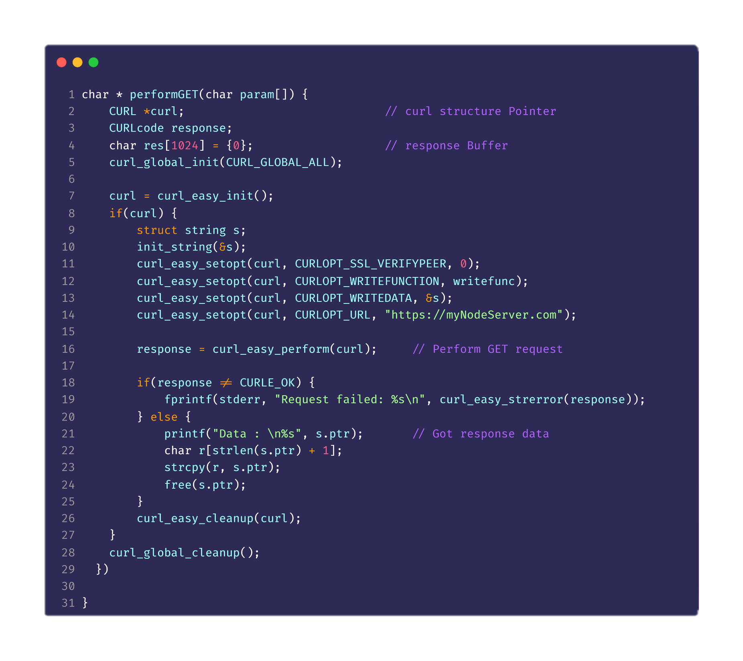
GET query function

Slide 14
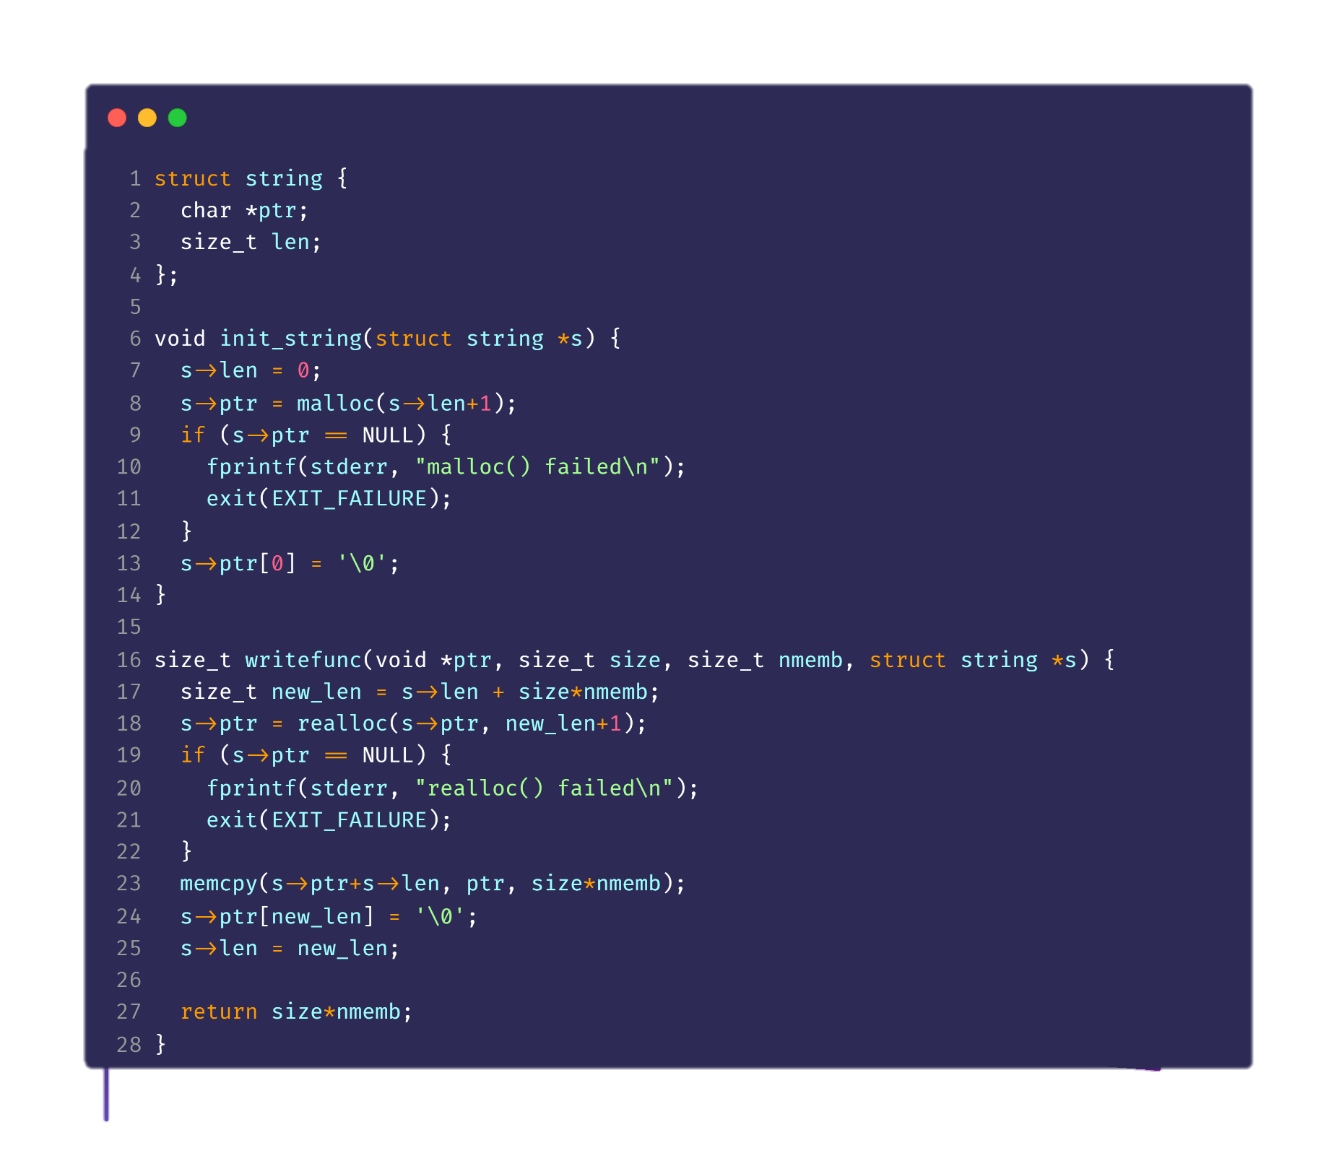
Response Buffer Helper Functions

Slide 15
Major Implementation
Phase 2 ( middleware side ):
Relaying Client Side request to weather server and parsing JSON data in return.
Start by including the Express library for capturing HTTP requests.
Create an instance of our Express app.
Configure app Object to change origin referer header to * to allow CORS requests form any domain.
Create a route to handle request.
Parse the request body to obtain the parameters., recompile request URI for the primary weather server ( to openweather.com ).
Fetch data from primary server, and parse it (as returned data is in JSON format ).
Simplify and stringify the required data and forward it tom the client side.

Slide 16
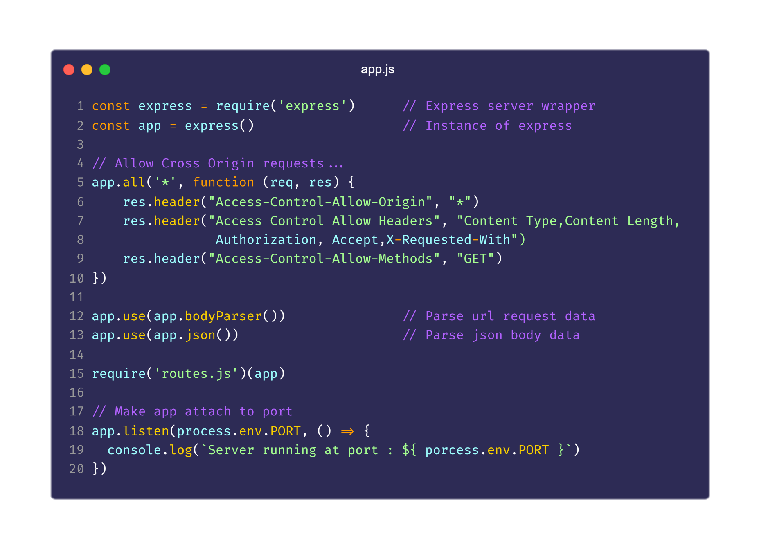
Middleware Server implementation ( with Express )

Slide 17
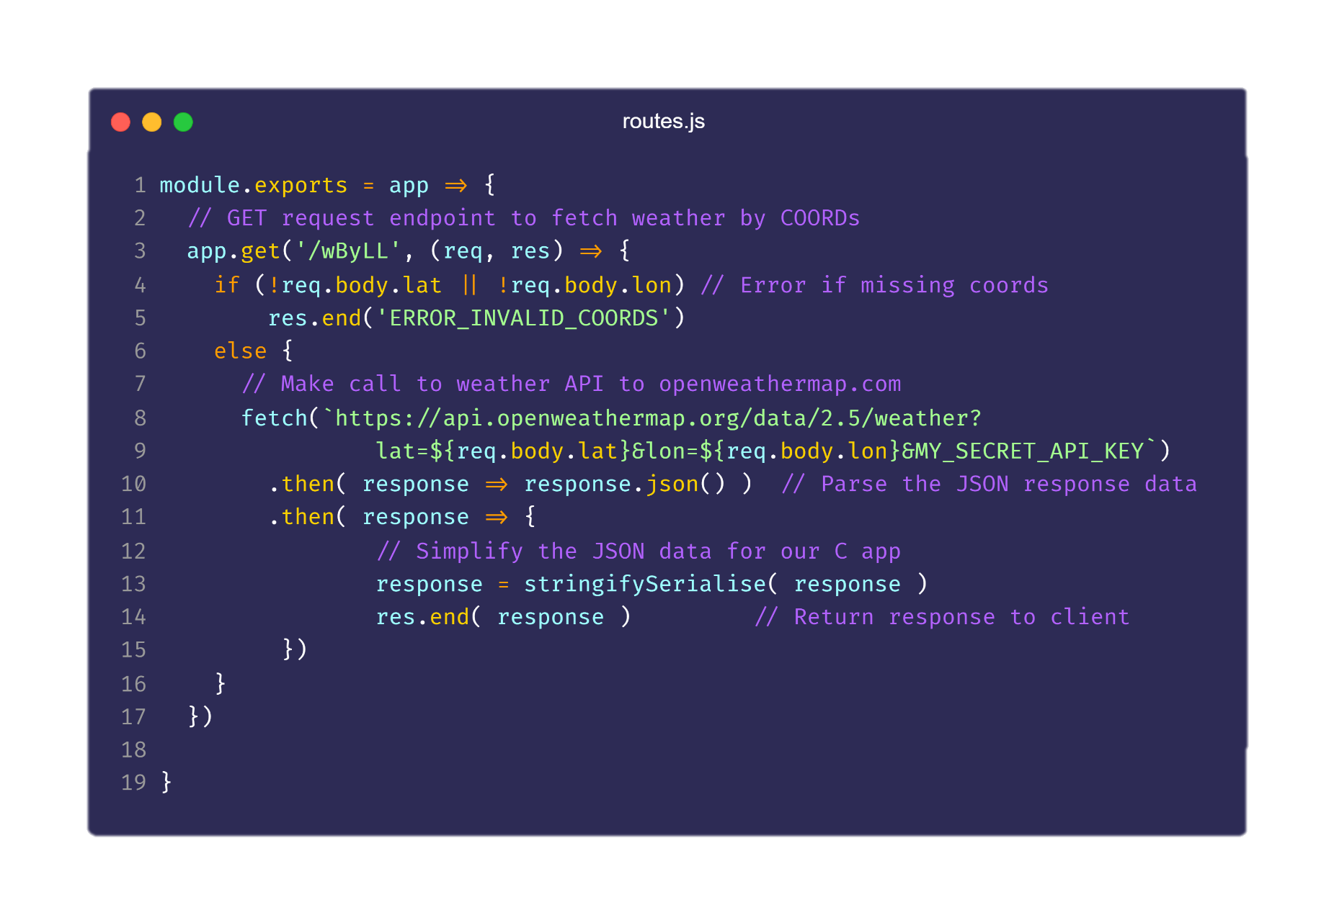
Route to handle incoming requests ( responding with stringified data )

Slide 18
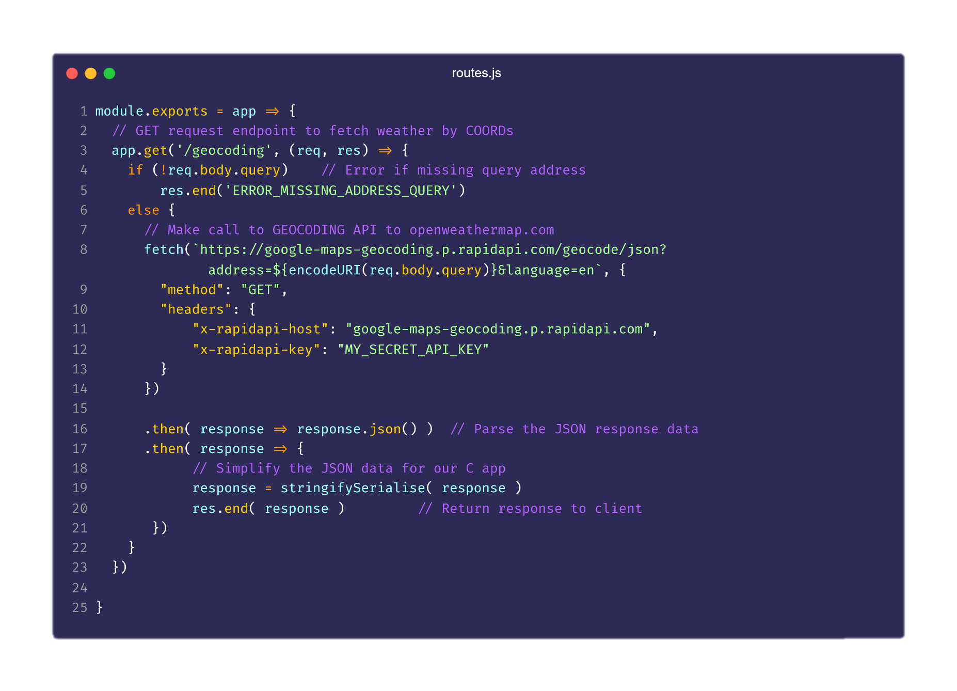
Middleware Server implementation ( listener for Geocoding API )

Slide 19
CONCLUSION
To Sum up,
By taking up this kind of project, we are depicting that some Old and Primitive language can also be used to create an application that can work with modern day technologies which even students can implement on their own.
We (in general) pulled up Https handshakes, RSA key exchange, GET, POST requests, RESTful APIs and lastly , data parsing from stringified data.
We used the local secondary storage in order to store application data including user’s Home and Favourites locations.
We also learnt about how to use various 3rd party libraries in our applications, how to build and compile them .

Slide 20
Future Work required
Some Future Plans including but not limited to …
Adding GUI support so as to increase convenience in use.
Compile the programs for different platforms and Operating Systems including Androids, Chromebooks , etc.
Adding hardware access to find coordinates using GPS on supported mobile platforms.

Slide 21

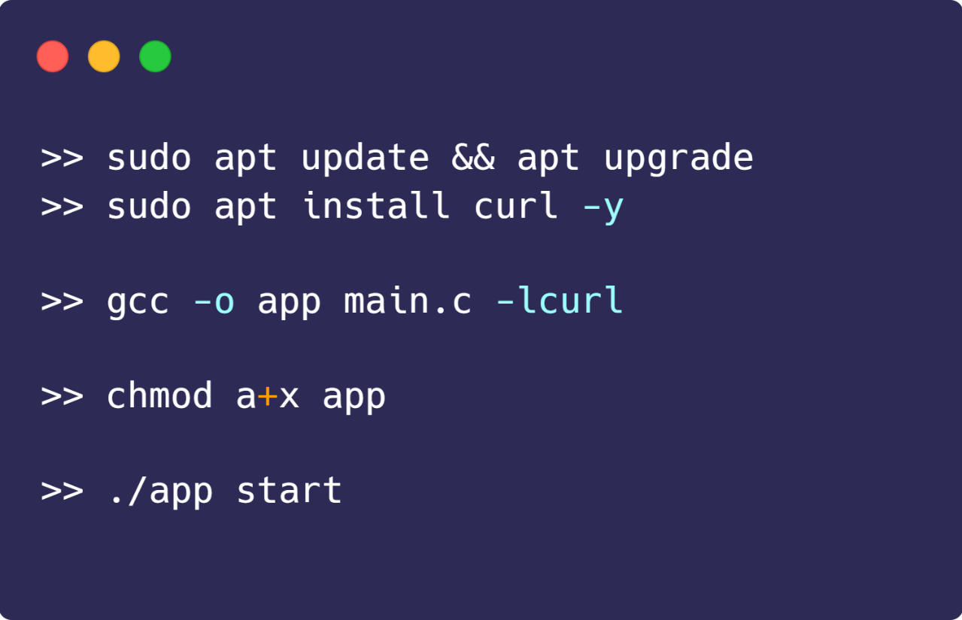
Project Build Process and sample Menu
Phase 1 ( Building Client side )
Update system to latest .
Install LibcURL library .
Compile C source with –lcurl flag to link assembler of cURL
Add executable permission using chmod a+x
Launch process.

Slide 22
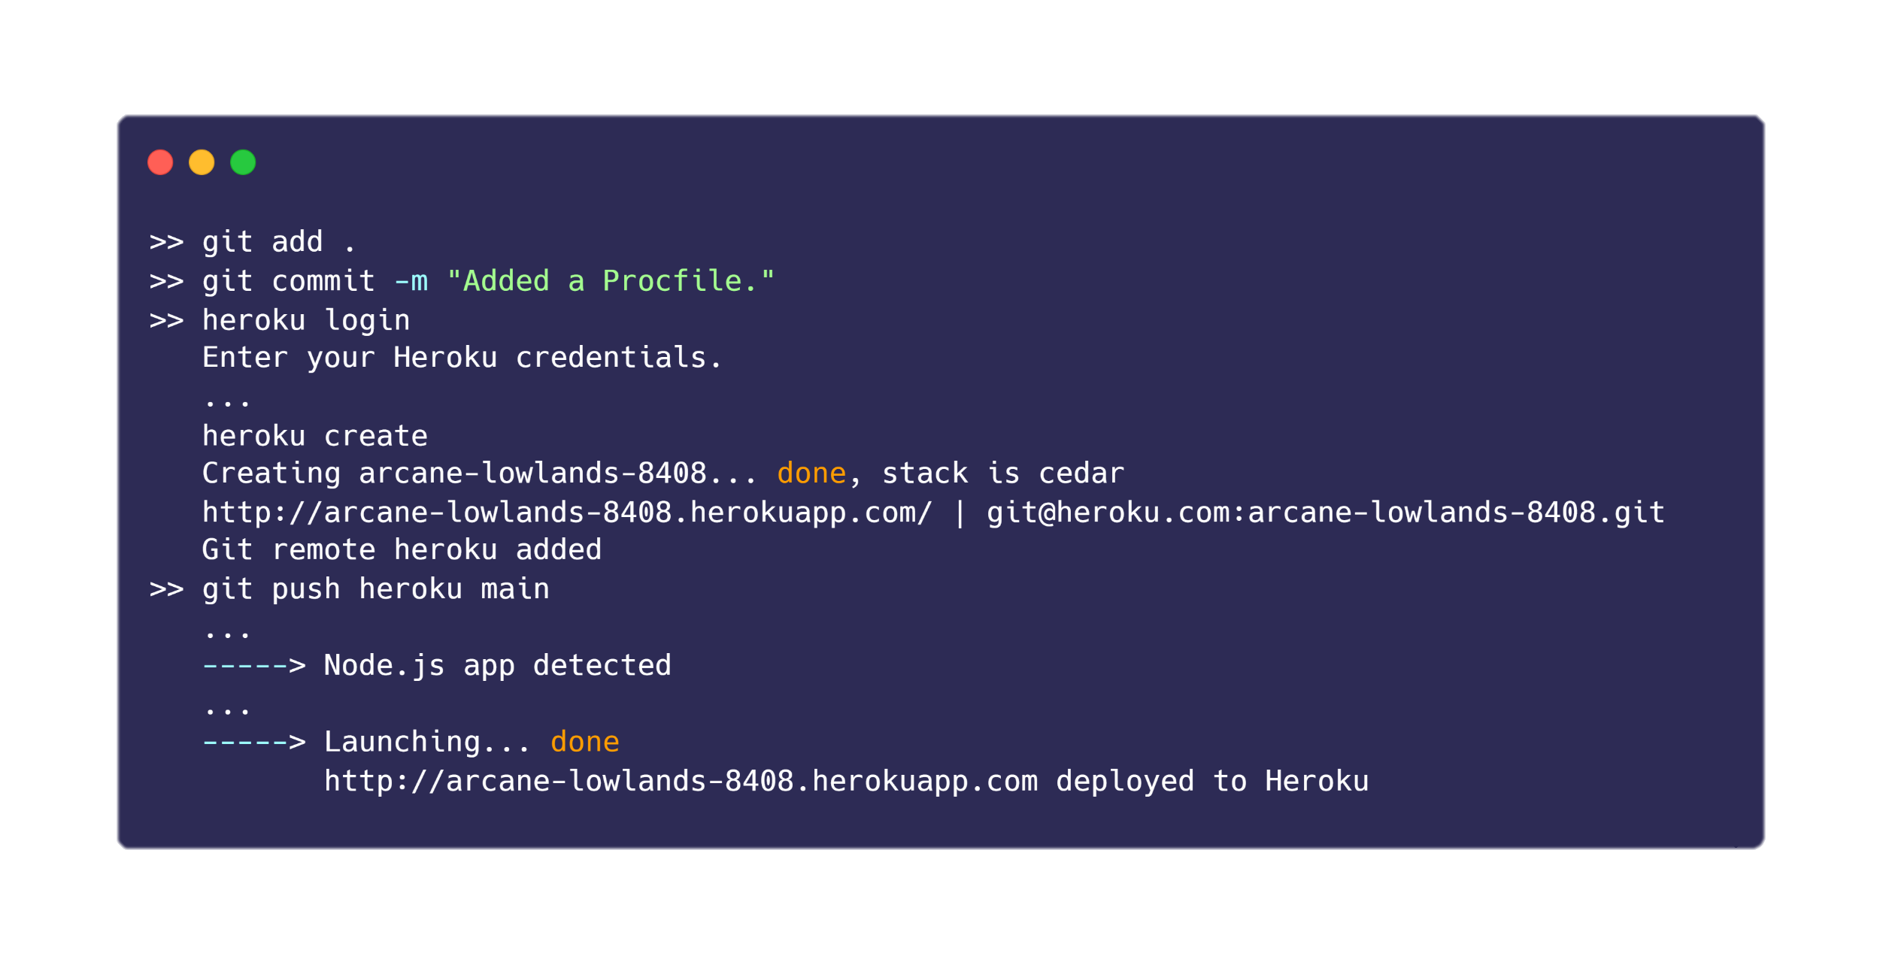
Project Build Process and sample Menu
Phase 2 ( Deploying server side )

Slide 23
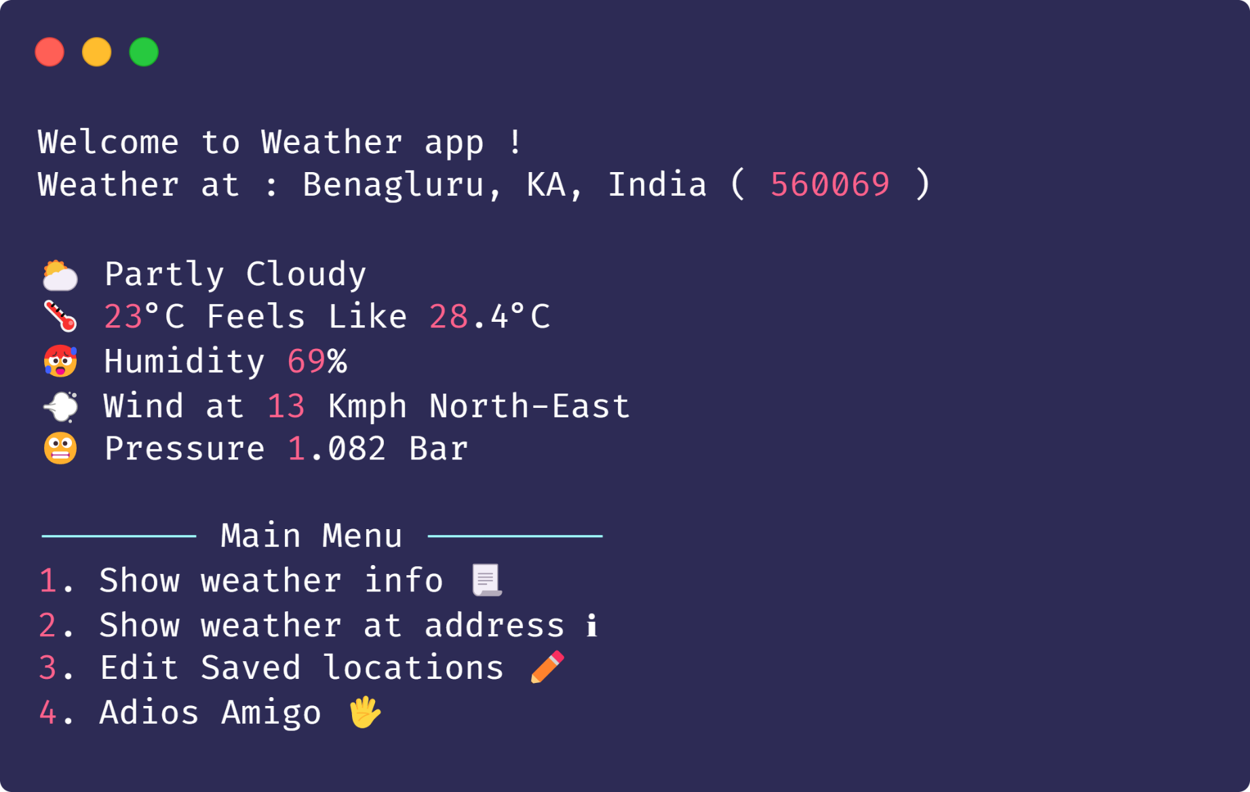
Project Build Process and sample Menu
Main Menu

Slide 24
Suggestions ?

Slide 25
Thank You !

